Slide 1

Write bug free python code with functional programming
Siddharta Govindaraj

Slide 2





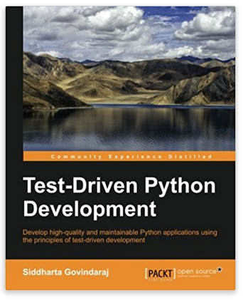
www.playfulpython.com
@playfulpython
https://www.linkedin.com/in/siddharta/

Slide 3
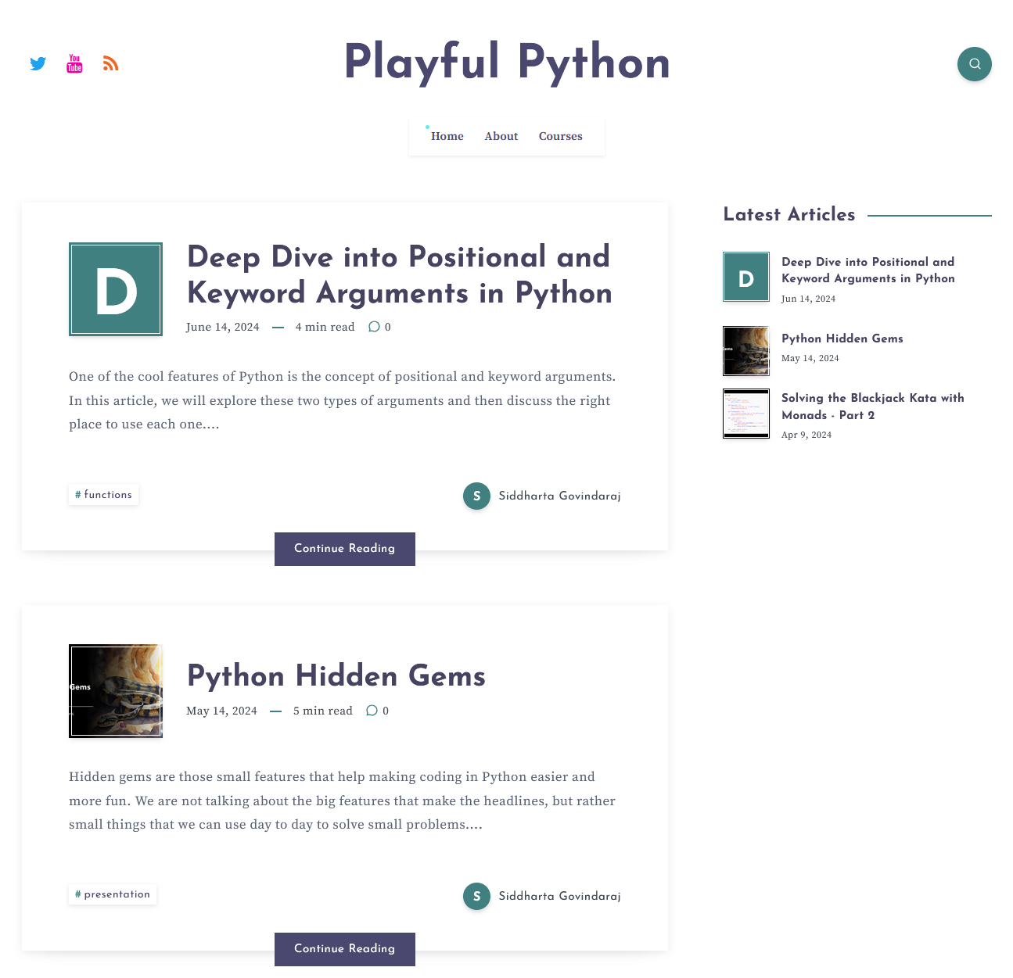

Slide 4
Pre-requisites for the workshop
You have a laptop with Python 3.10+ installed on it
You have a text editor or IDE to edit code
You know how to get code from github
You already have some knowledge of Python. We will be using advanced features of Python

Slide 5
Demo: Blackjack
https://www.wikihow.com/Play-Blackjack

Slide 6
Agenda
Part 1: Introduction
Part 2: Higher Order Functions
Part 3: Data
Part 4: Generators
Part 5: Monads
Part 6: Blackjack

Slide 7
Part 1: Introduction
What is functional programming?

Slide 8
What is a function?

Slide 9
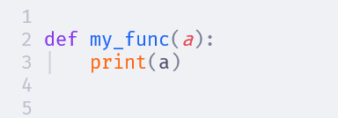

Slide 10
What is a function in maths?
functions have an input
y = 2 * x + 1
that is mapped to an output

Slide 11

What is a function in maths?
y = 2 * x + 1 z = a²
h = z ∘ y
= z(y(x))
Functions can be composed to create new functions!!
= (2 * x + 1)²
= (4 * x² + 4 * x + 1)

Slide 12
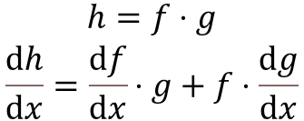
Functions are abstractions
y = 2 * x + 1
x can be any integer
$$\begin{matrix}h=f⋅g \\ \frac{ⅆh}{ⅆx}=\frac{ⅆf}{ⅆx}⋅g+f⋅\frac{ⅆg}{ⅆx}\end{matrix}$$
…or a fraction
…or a real number
…or imaginary number
…or anything that supports * and + operations with number

Slide 13
What is functional programming?
Functional programming is about applying the principles of mathematical functions to programming
Write small functions with simple inputs and outputs
Combine these small functions to create bigger functions
Create abstractions for repeating patterns of usage

Slide 14
What is functional programming?
Small functions are easy to test and understand
Abstractions allow us to apply coding patterns in a generalised way

Slide 15
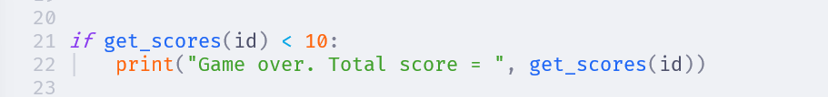

Slide 16
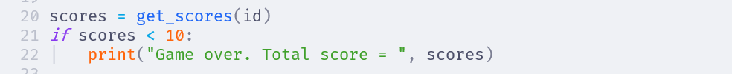

Slide 17
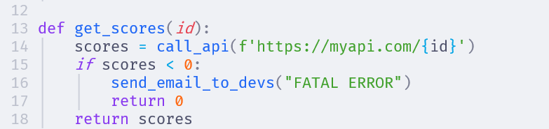
This function has some input apart from the function parameters
This function has some output apart from the return value
These extra inputs and outputs are called side effects

Slide 18
This is not a function in the maths sense

Slide 19
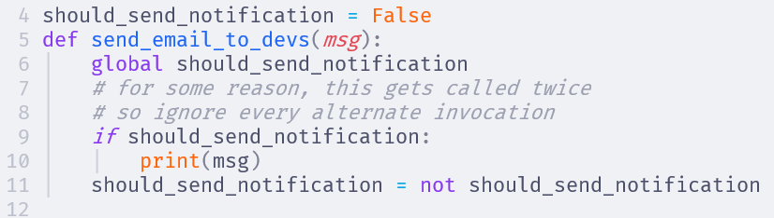
More side effects! This is hidden state
This function has different behaviours when we call it at different times with the same arguments

Slide 20
Two types of functions
Pure functions are functions in the mathematical sense. They take all inputs from parameters and return all outputs from return values. Also called calculations
Impure functions have side effects, or hidden state. Their behaviour is unpredictable. We cannot infer the inputs or outputs from seeing the function call. We must read the implementation. Also called actions

Slide 21
Two types of functions
Pure functions are easy to understand and reason about. Pure functions are 💖. Write more pure functions!
Impure functions are complicated to reason about and break easily. Be very, very, very careful with impure functions🤢

Slide 22
Two types of functions
But, but, but… we do need to interact with APIs, and DBs and the outside world. A program that cannot do that is useless
The goal of functional programming is to cleanly separate out calculations and actions in the design, so that the actions can be contained carefully

Slide 23
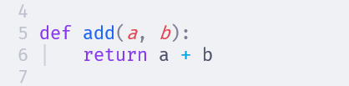

Slide 24
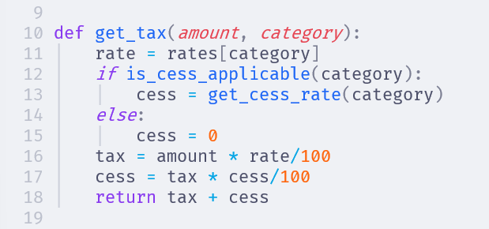

Slide 25
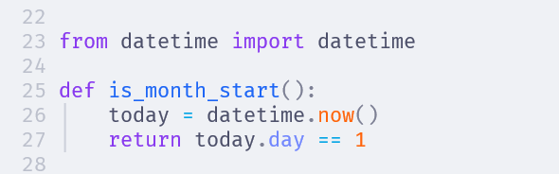

Slide 26
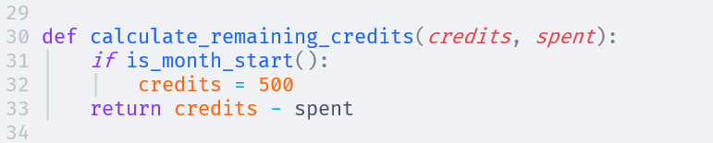

Slide 27
Oh my!! Impure functions are like a virus. If a function uses an impure function, it becomes impure. And if any other function calls this one, then…

Slide 28
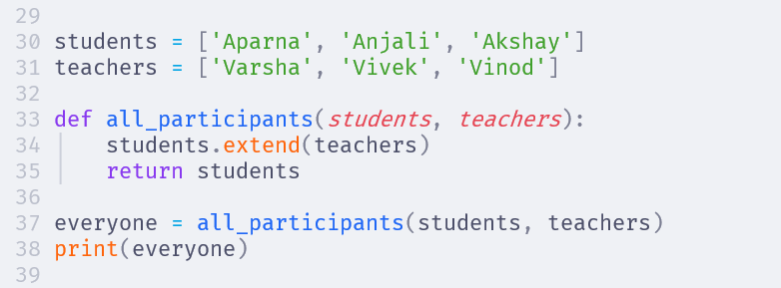

Slide 29
Exercise: 15 mins
Complete 01_exercise.py and 02_exercise.py

Slide 30
Part 2: Higher Order Fns
Functions that transform functions

Slide 31
Write functions to add, sub, mul, div two numbers

Slide 32
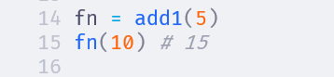
Write a function add1 which takes the inputs one at a time

Slide 33
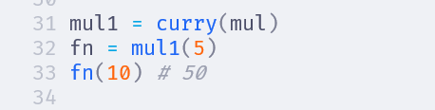
Write a function curry which takes any binary function as input and returns a function that can be called one param at a time

Slide 34
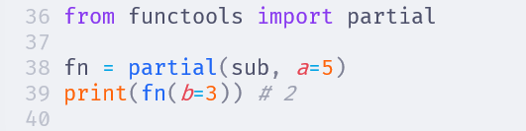
functools.partial

Slide 35
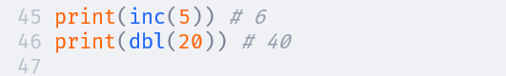
Using partial, create an inc function and a dbl function

Slide 36
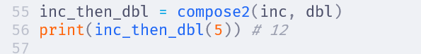
Write a function which given two functions will compose them

Slide 37
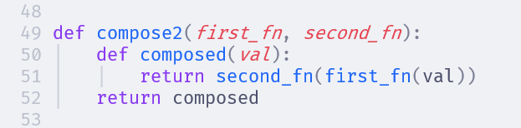
Write a function which given two functions will compose them
Homework Generalise this to compose any number of functions

Slide 38
Part 3: Data
Mutable and Immutable data

Slide 40
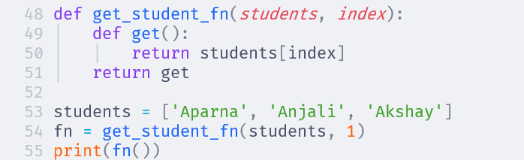

Slide 41
A list is mutable. If we change it, it affects all the other places where that list is used, making the operation impure

Slide 42
List operations
Prefer + instead of .extend()
Use [*lst, value] to append value to lst
Use lst[:-1] to remove the last element of a list
Use [val for val in lst if val != target] to remove a target value from a list
Use lst[:] to make a copy of a list

Slide 43
Dict operations
Use the union operator | to add or update keys in a dictionary
Use .copy() method to make a copy of the dictionary

Slide 44
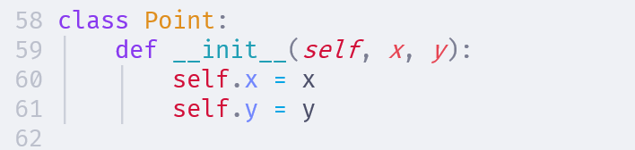
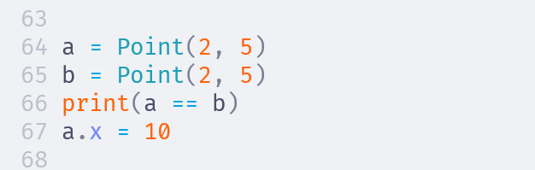
False
Mutable

Slide 45
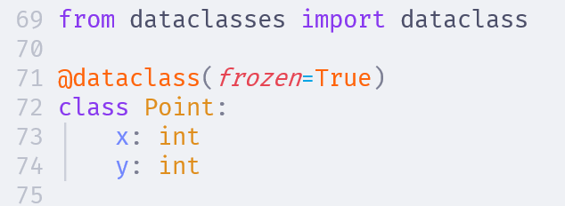
True
Error

Slide 46
Lesson Learned
Be very, very, careful with mutating data. It makes all the other functions that use the same data impure
tuples, numbers and strings are immutable in python
list, dict are mutable, so prefer immutable operations or make a copy and mutate
dataclasses make it easy to make immutable data structures

Slide 47
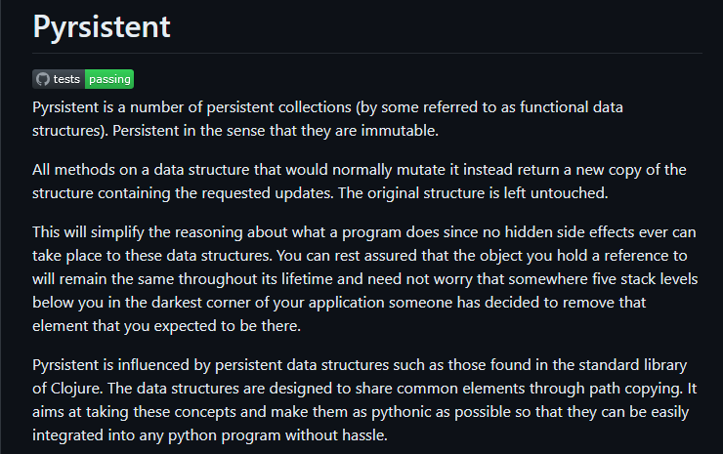
Or pip install pyrsistent

Slide 48
BREAK
20 mins

Slide 49
Part 4: Generators
Working with lazy streams

Slide 50
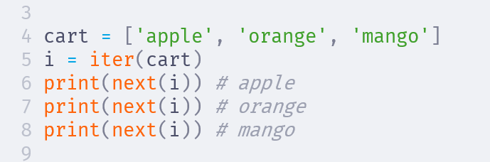

Slide 51
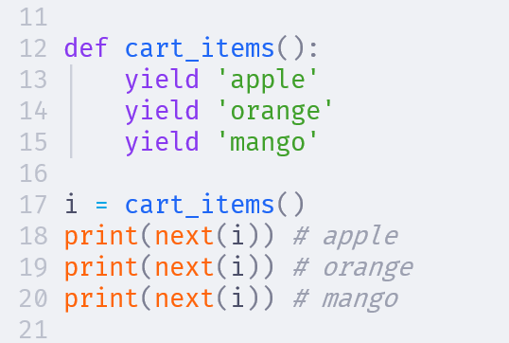

Slide 52
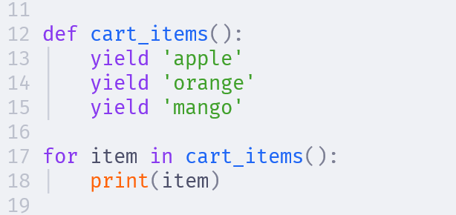

Slide 53
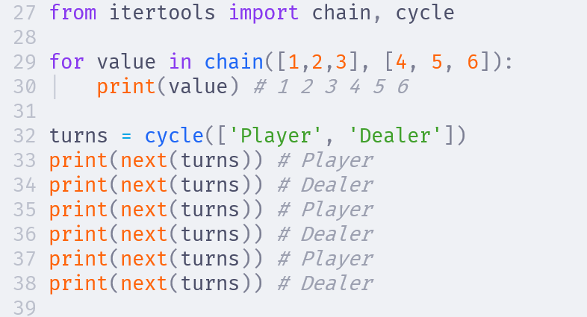

Slide 54
Functions vs Generators
Functions map an input to an output
A generator maps an input to a stream of multiple outputs
Function uses return to return an output. Generators use yield to return an output
Functions always start execution from the start. Generators resume from the previous yield
Generators are lazy - they only compute the next output when asked for it
Because of this, generators can potentially be infinite

Slide 55
Part 5: Monads
Abstractions for managing context

Slide 56
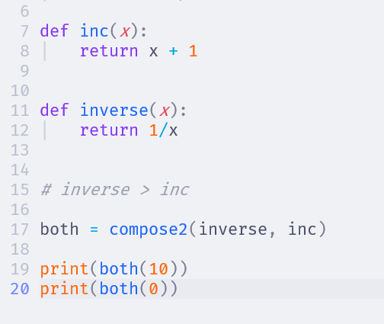

Slide 57
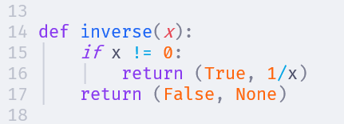
But now, inc() function cannot be composed with this!

Slide 58
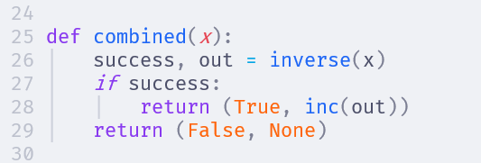
Can we abstract this pattern?

Slide 59
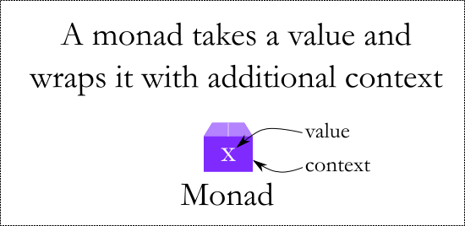
Maybe Monad

Slide 60
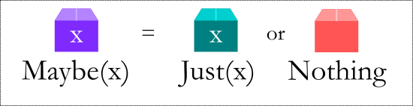
Maybe Monad

Slide 61
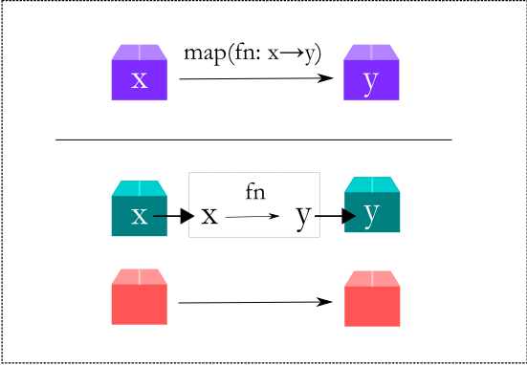
Maybe Monad

Slide 62
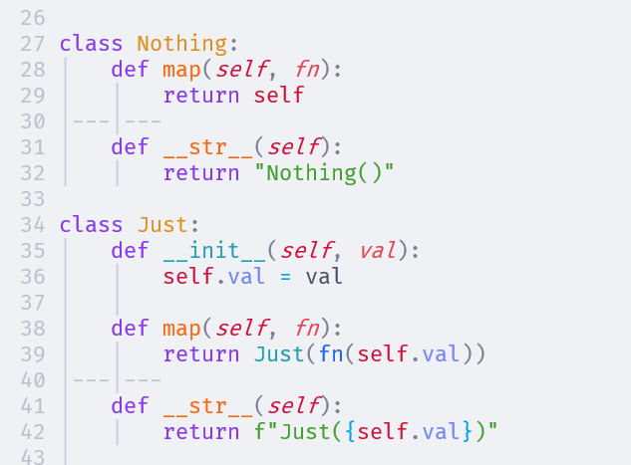

Slide 63
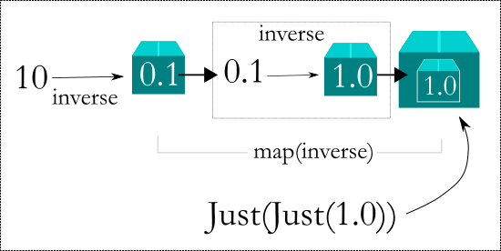
Maybe Monad

Slide 64
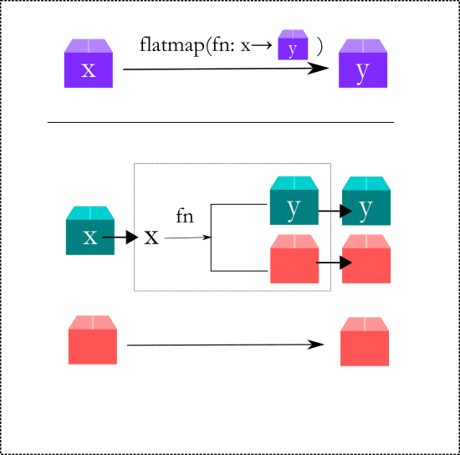
Maybe Monad

Slide 65
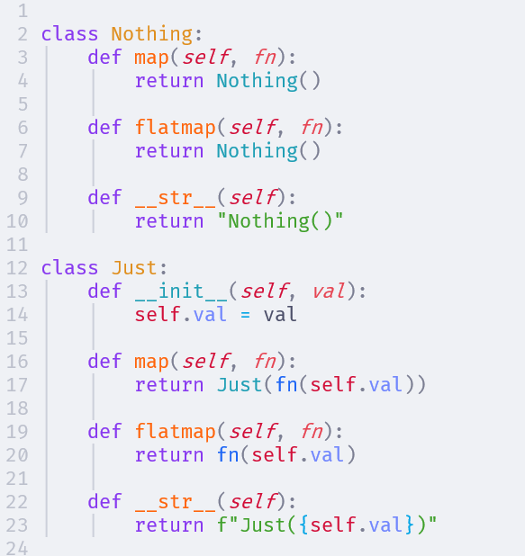

Slide 67
MultiValue Monad
This monad can be used to represent items that can have multiple values
Eg: sqrt returns +x and -x as output
Evaluate all possible solutions for
sqrt(sqrt(sqrt(4) + 2) +2)

Slide 68
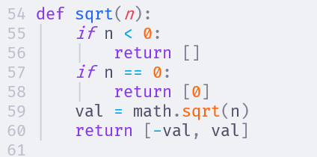

Slide 69
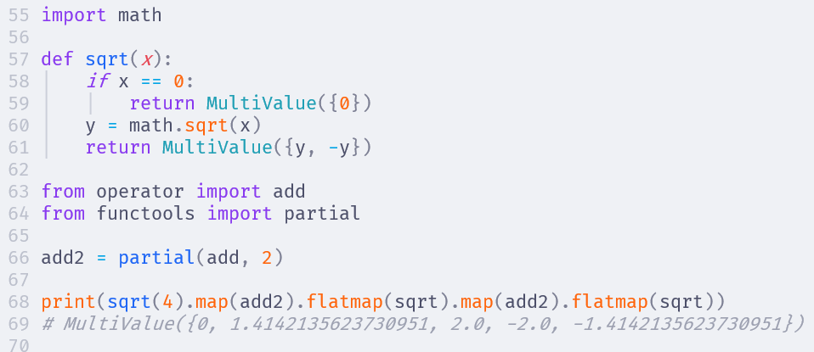

Slide 70
Part 6: Blackjack
Abstractions for managing context

Slide 71
Blackjack
Blackjack has a deck of cards
We need to be able to draw cards from the deck and add it to a hand
We need to be able to score the cards in a hand

Slide 72
Data Types
A card has a rank (1 to 13) and a suit (S, H, D, C). We can use a dataclass to represent this
A deck is a list of cards. When we start, the deck has Cards of all possible combinations of rank and suit
A hand is also a list of cards. Although in the code it is the same data type as a deck, conceptually a hand is different from the deck, so we will create a new data type for it

Slide 73
Getting started
Open the file blackjack.py in your editor
Create a Card dataclass
Create a function to return a new deck
Create a function to shuffle a deck
Create a function to compose the above two and return a shuffled new deck

Slide 74
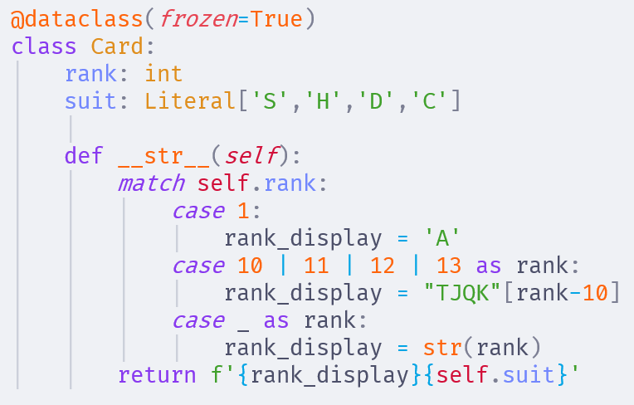

Slide 75
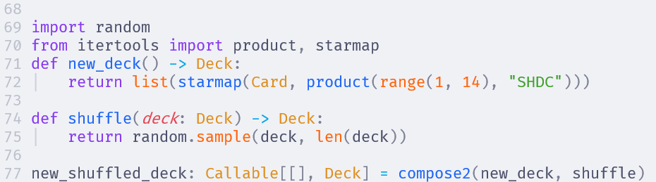

Slide 76
Scoring a hand
Each card has a score
Jack, Queen, King are worth 10 points
Number ranks are worth their number
Ace can be worth 1 point or 11 points, whichever is better for the player
A, K = 21 points
A, A, K = 12 points
A, 8, 5 = 14 points

Slide 77
How to write the scoring algorithm?
We can find all possible sums
Then choose the maximum one that does not bust
A, K = {11, 21}
A, A, K = {12, 22, 32}
8, 7 = {15}
A, 8, 7 = {16, 26}
8, 7, 10 = {25}. Bust

Slide 78
Use MultiValue monad to represent the points
A = MultiValue({1, 11})
K, Q, J = MultiValue({10})
All other = MultiValue({rank})
Total possible value of hand = sum of all points in the hand
Then filter all those values that bust
And choose the max of what is remaining

Slide 79
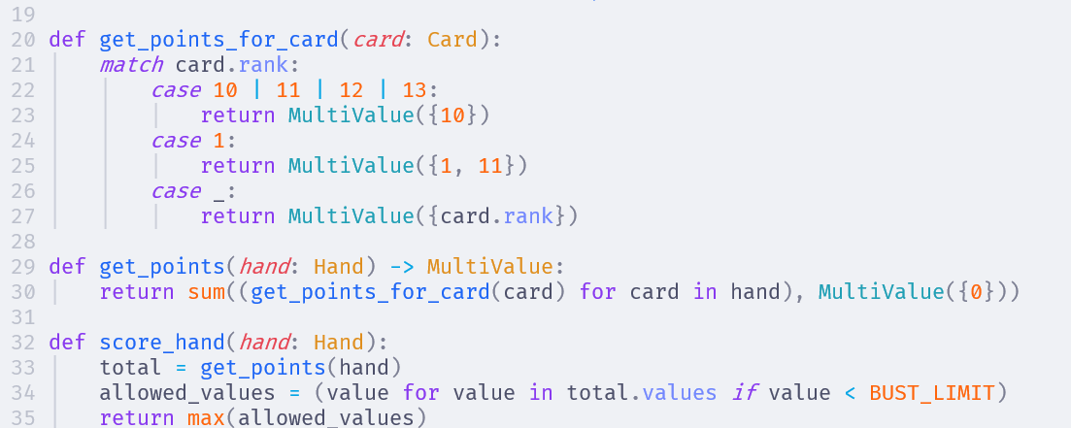

Slide 80
Now to draw a card
Given a deck, we need a function that will take the top card out. Return None if the deck is empty
Then we need another function to add the card to a hand
Finally, we combine both of these in draw_to_hand where it will draw from the deck, and add it to the hand. If the deck is empty then shuffle a new deck

Slide 81
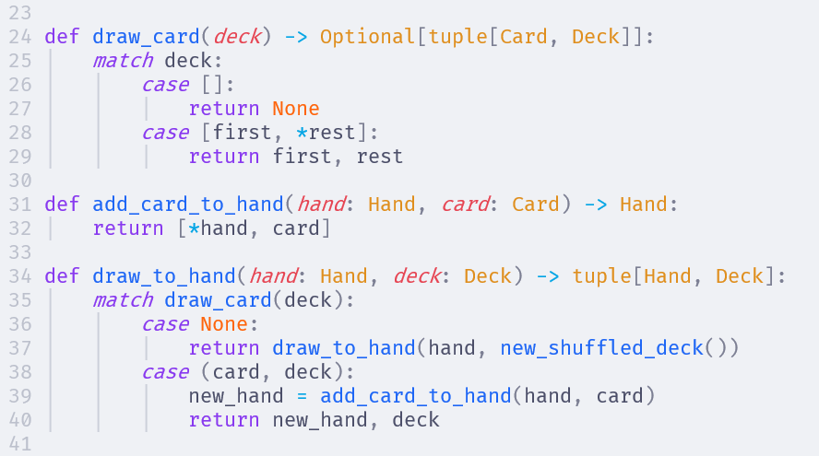

Slide 82
Finally the core game loop
Everything we have so far are pure functions. Now we need the core game loop
Setup the initial game state
List of players: Player, Dealer
Hands of each of the players: []
Deck: A new shuffled deck
And we need actions to get the input from the player and dealer

Slide 83
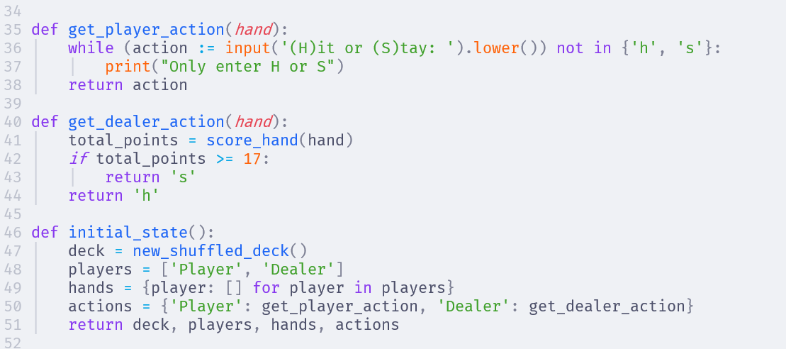

Slide 84
Finally the core game loop
Now we loop through each player one by one
Ask if hit or stay?
If hit, add a card to hand from deck
If now bust, end the game
If stay, remove the player from the list of players
When no more players left, the game is over

Slide 85
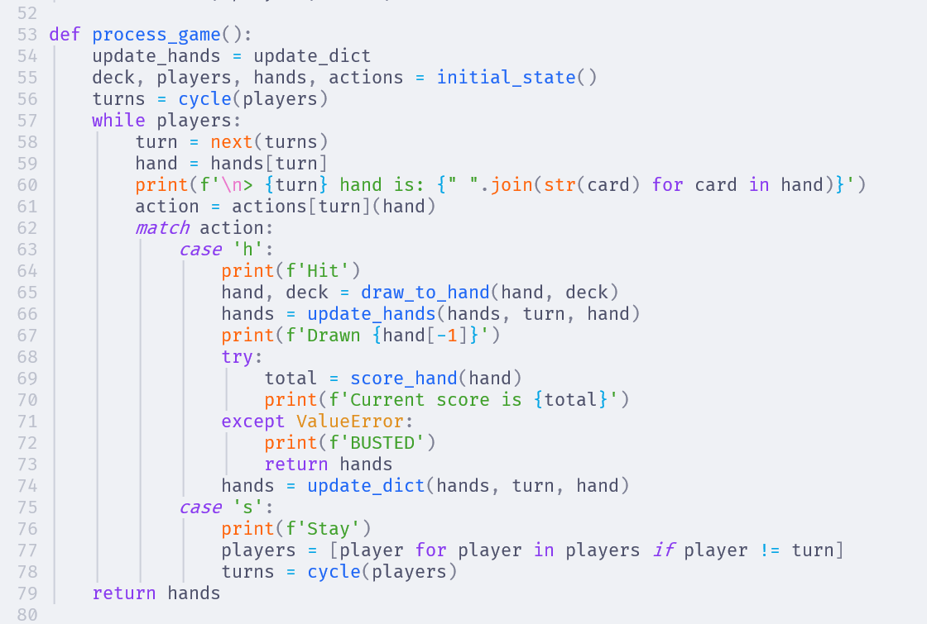

Slide 86
Homework
When a hand is busted, get the score_hand() function raises a ValueError (from the max function)
Typically, functional programming does not use exceptions. We use the Maybe monad to signify an error.
Change the code to use Maybe instead of the exception

Slide 87
Homework
There are a lot of print() everywhere. This is an action. How can we make this code more functional?
See the file blackjack_stream.py for an example how to handle it
Then research the Writer monad which is an abstraction on the same concept

Slide 88
Advanced Homework
What about the place where we ask the user for the input? This is also an action and it is making the core gameplay loop into an action.
How can be get it out of this function so that the core gameplay loop logic becomes a pure function?
Look up how to do coroutines in Python

Slide 89
www.playfulpython.com
@playfulpython
https://www.linkedin.com/in/siddharta/

